Slide 1
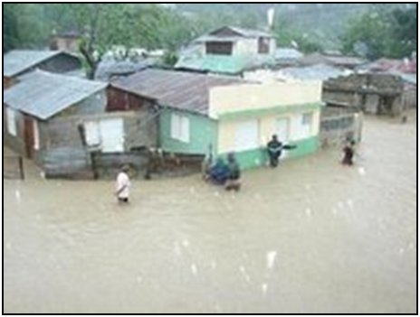
Rio Boba Flooding
Bryan Priebe
Josh Thompson
Frans Lambrechtsen

Slide 2
Overview
Project description
Objectives
Location of watershed
Rio Boba team
Analysis
Solutions

Slide 3
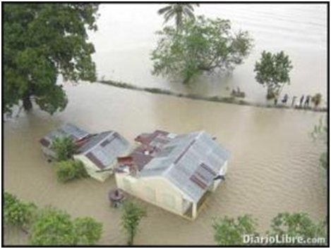
Project Description
Flooding occurring downstream
Analysis of the Rio Boba watershed needed
Examine flood inundation
Explore possible
alternatives

Slide 4
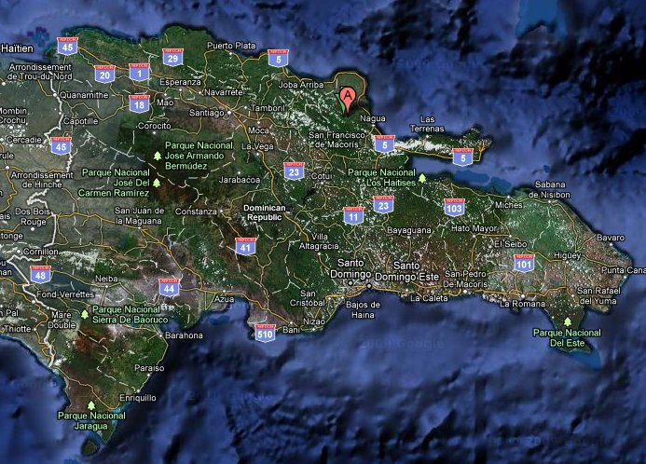
Location
Located directly north of Santo Domingo
The Rio Boba flows from the mountains to the ocean
River outlet is located near Nagua

Slide 5
Rio Boba Team
Bryan Priebe
Josh Thompson
Frans Lambrechtsen
Sandra Clases
Yenny Rodriguez

Slide 6
Analysis
Use WMS to delineate watershed
Use of HMS and GSSHA to calculate flow
Peak flow obtained using precipitation data
Obtain/analyze channel cross-sections
Insert data into HEC-RAS model
Determine areas of flood inundation
Compare using HEC-RAS and GSSHA

Slide 7
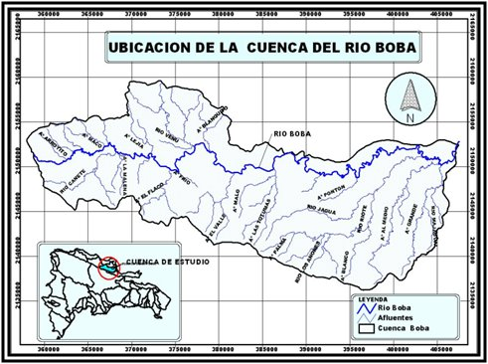
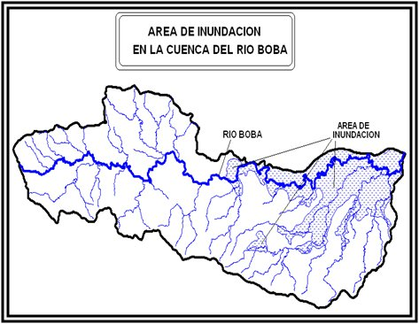
Solutions
Preliminary ideas
Early warning system
Retention walls
Other ideas
Detention basin
Widen channel

Slide 8
Questions?

