Slide 1
Los Quemados
Flood Solution Study

Slide 2
Project Scope
Gather Basin Images, Maps, Meteorological Data and Analyze Basin Characteristics
Obtain Data Gathered From Field Work
Develop WMS and GSSHA Models
Calibrate the Models
Run Simulations for Proposed Structural and Non-Structural Improvements
Comparative Analysis of the Improvements
Provide Results and Recommendations

Slide 3
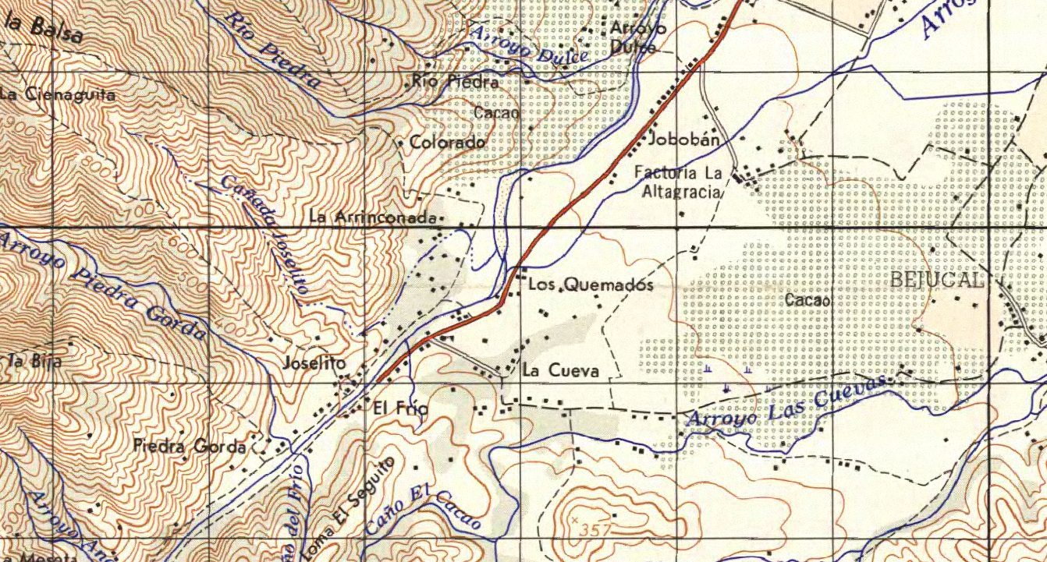
Los Quemados

Slide 4
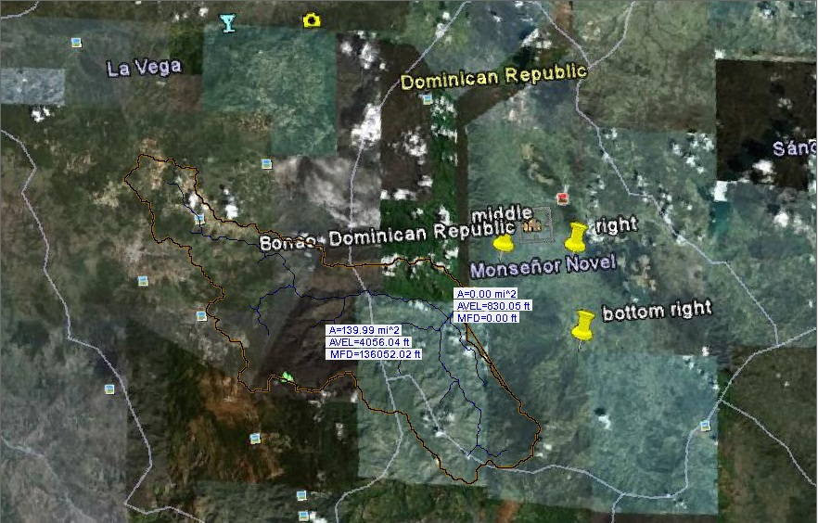
WMS Model

Slide 5
Suggested Solutions
Dams to control flood waters upstream
Relocation of the city’s inhabitants
Build an emergency alert system

